Slide 1
HR Analytics Case Study (Logistics Regression)
Group Name:
Deepak Aneja
Suresh Balla
Merin Jose
Fayiz Mayam Veettil
25 Mar 2018

Slide 2
Problem Statement
Objective
Understand the factors in order to curb attrition of the Company XYZ
Know which of the variables is most important and needs to be addressed right away
Company want to know what changes they should make to their workplace, in order to get most of their employees to stay in the company

Slide 3
Data Exploration
Dataset
Contains the information about the employees working in the Company XYZ
Around 4,400 employees records from Jan ’15 to Dec ‘15
Dataset across five different sheets including
General Information
Daily time in and time out details
Employees’ and Managers’ job satisfaction and work life balance survey data
The aim is to model the probability of attrition using a logistic regression

Slide 4
Step by Step Approach for Analysis
Cleaning and formatting data
Derive useful metrics out of data
Check the data density and correlations
Data Modeling
Conclusion

Slide 5
Data Cleaning and Manipulation
Check for possible data inconsistencies
Check for duplicate records
Check for NA values in the columns used for analysis
Status of data cleaning
No duplicate records found
Uses the column ‘Attrition’ as targeted variable
Created {n} dummy variables

Slide 6
Logistics Regression
24 different Models created

Slide 7
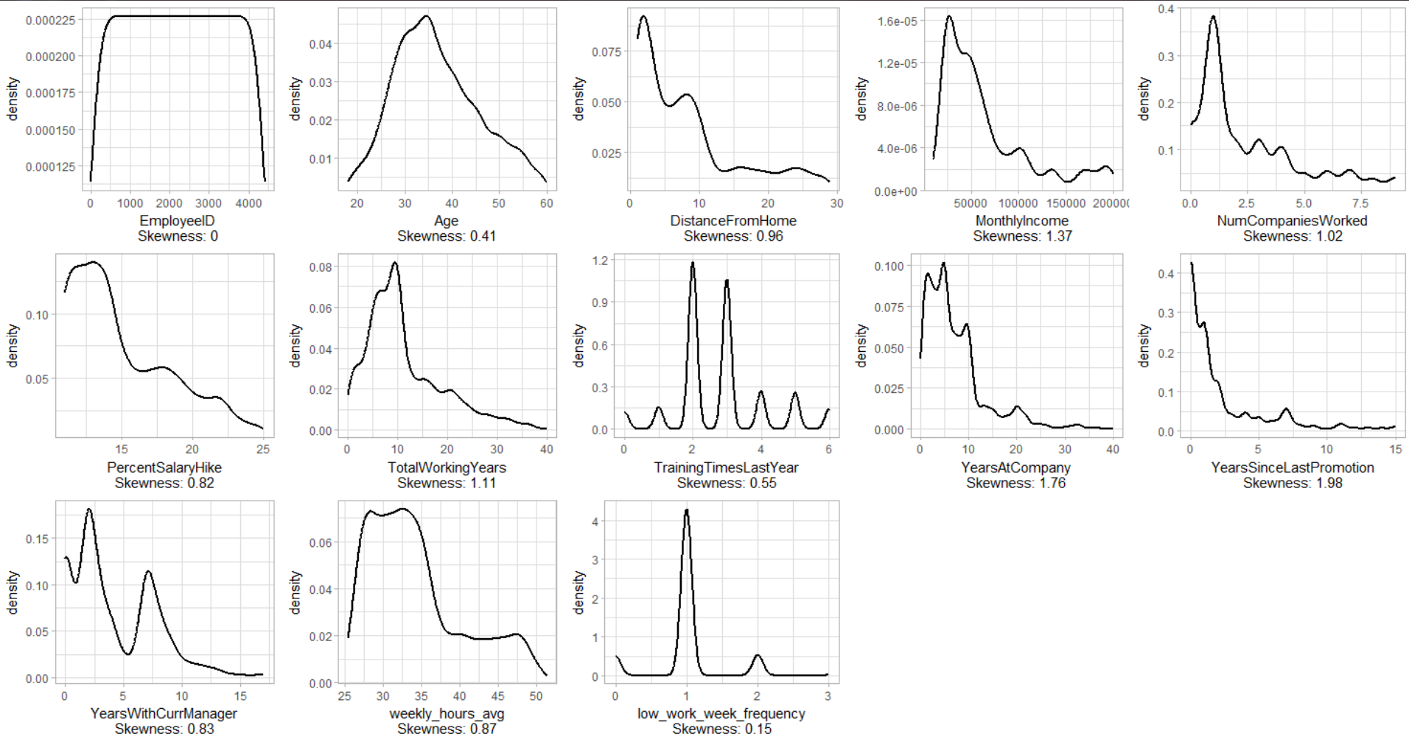
Data Density
Data density check on numerical data for further modeling

Slide 8
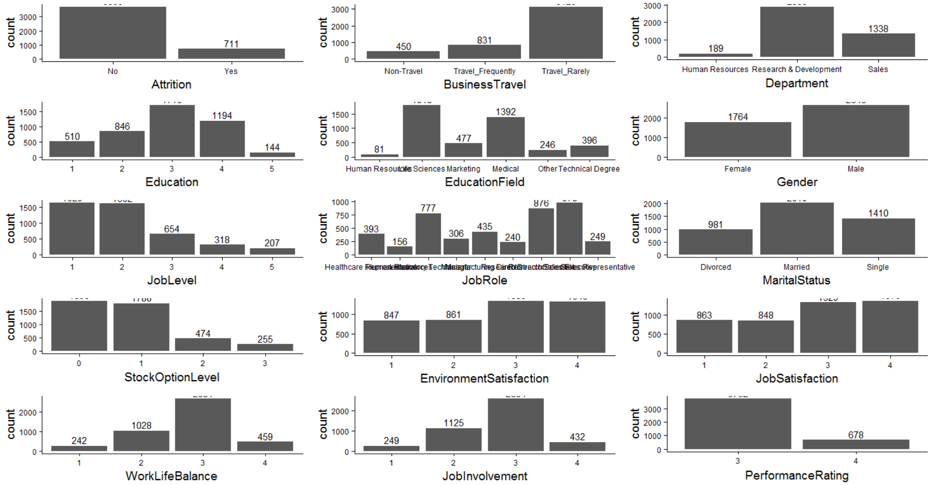
Data Density
Data density check on categorical data for modeling

Slide 9
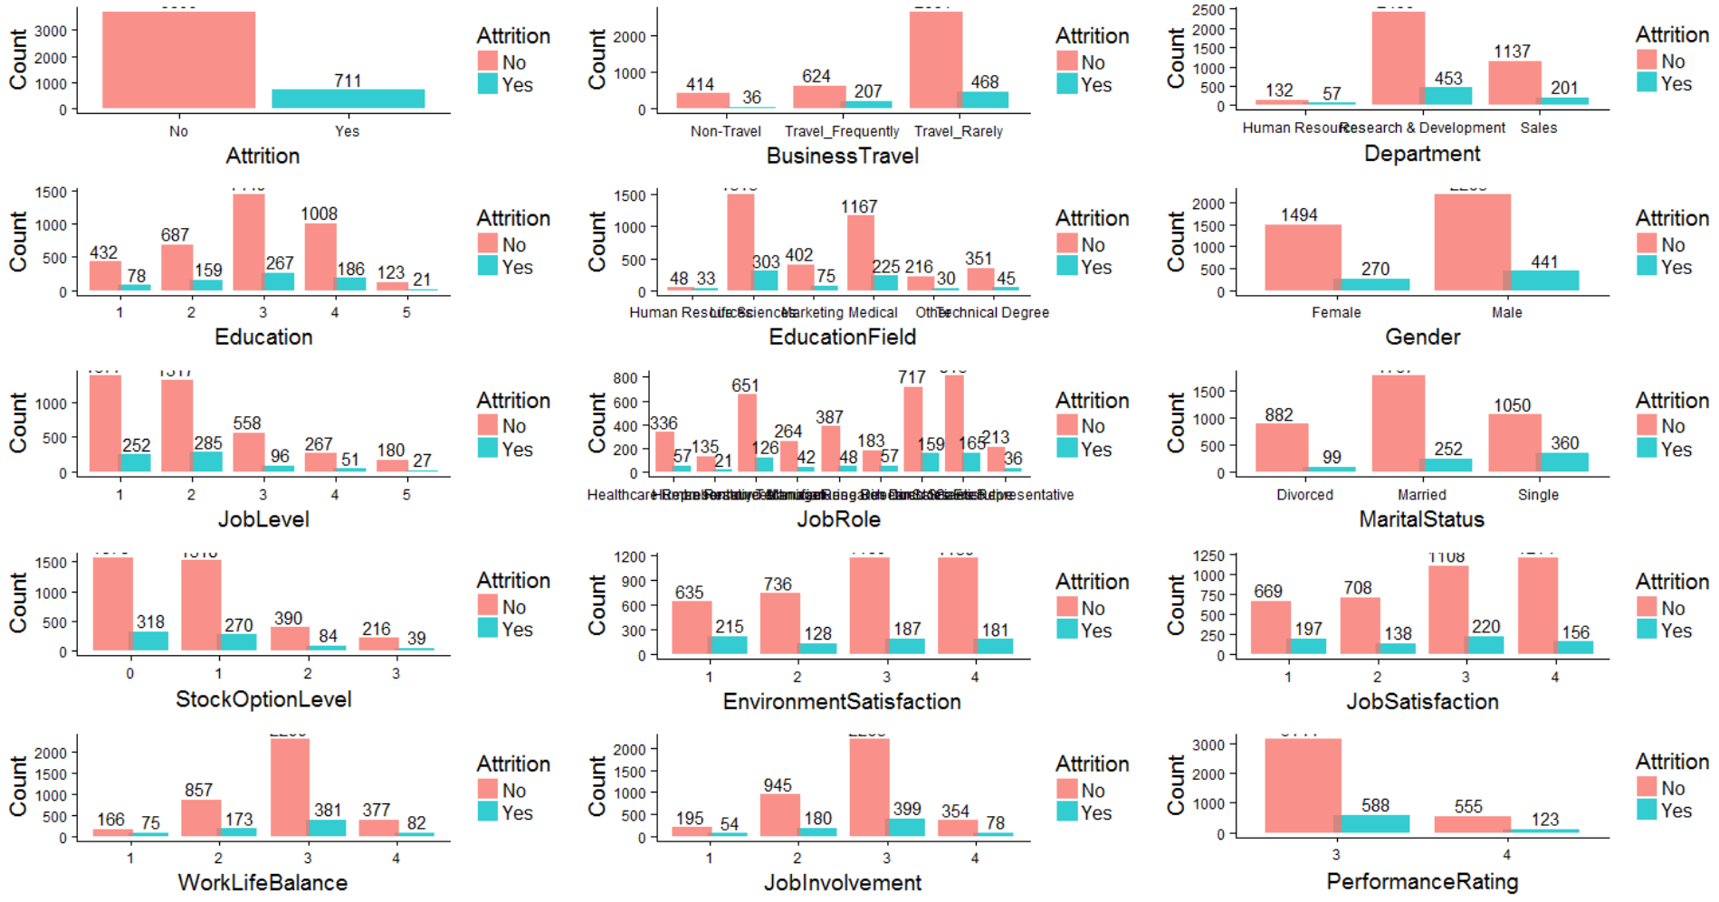
Univariate Analysis - I
XXXX

Slide 10
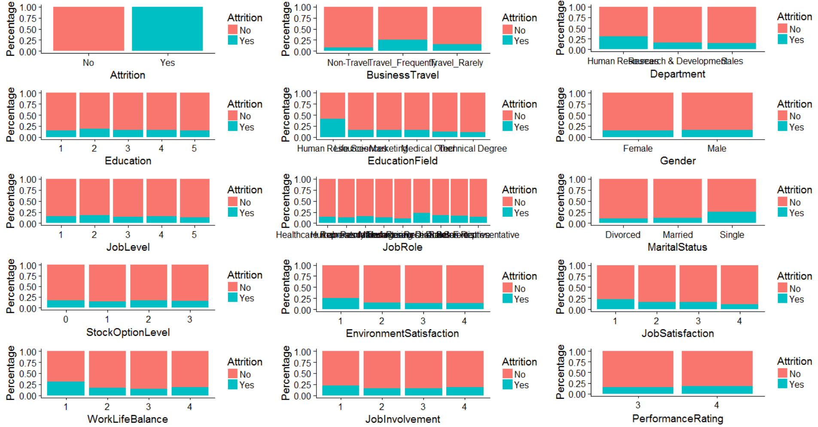
Univariate Analysis - II
XXXX

Slide 11
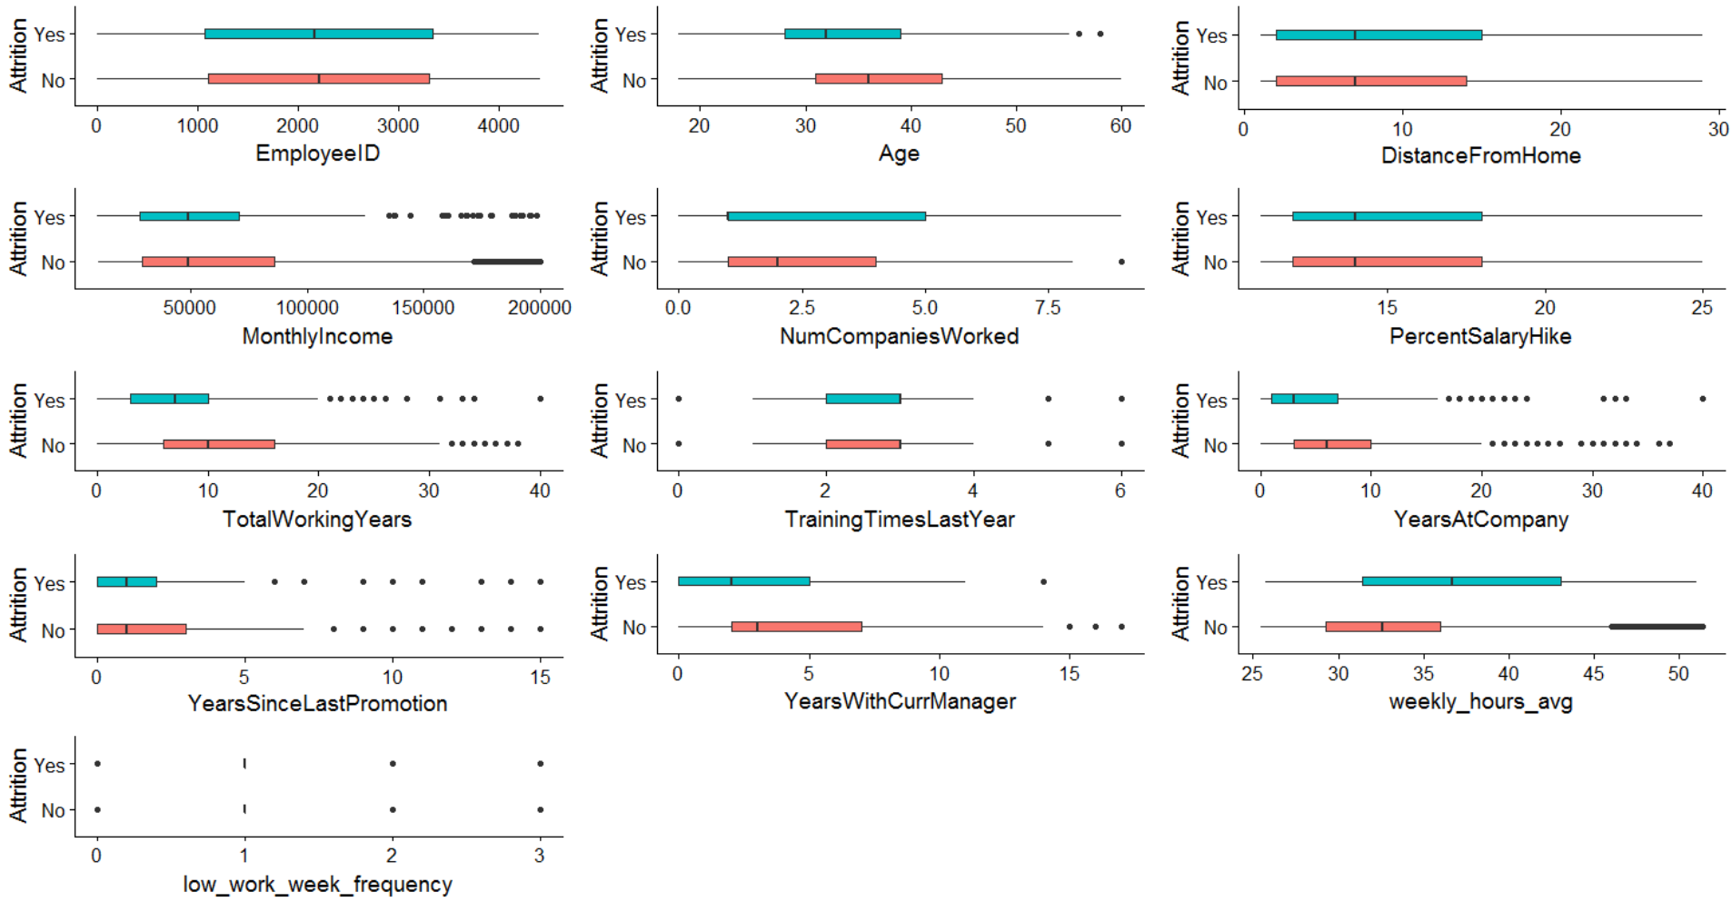
Attrition Status
XXXX

Slide 12
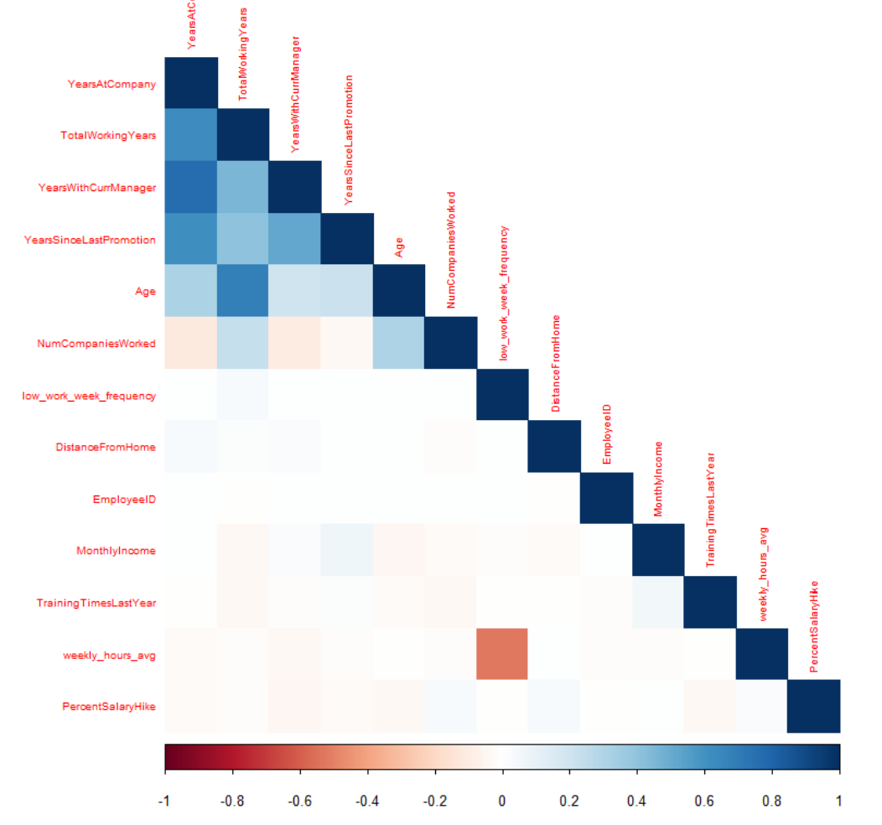
Data Correlation
Check the correlation between each variable for further modeling

Slide 13
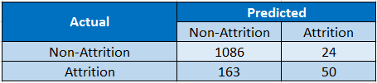

XXX
Actual | Predicted
 | Non-Attrition | Attrition
Non-Attrition | 1086 | 24
Attrition | 163 | 50
Accuracy | 85.87%
Sensitivity | 23.47%
Specificity | 97.84%

Slide 14
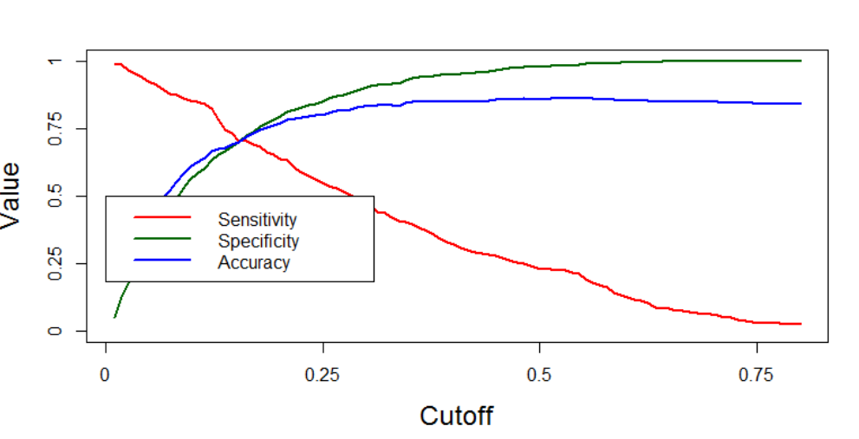
XXX

Slide 15
XXX

Slide 16
Coclusion
Check the correlation between each variable for further modeling

